Slide 1
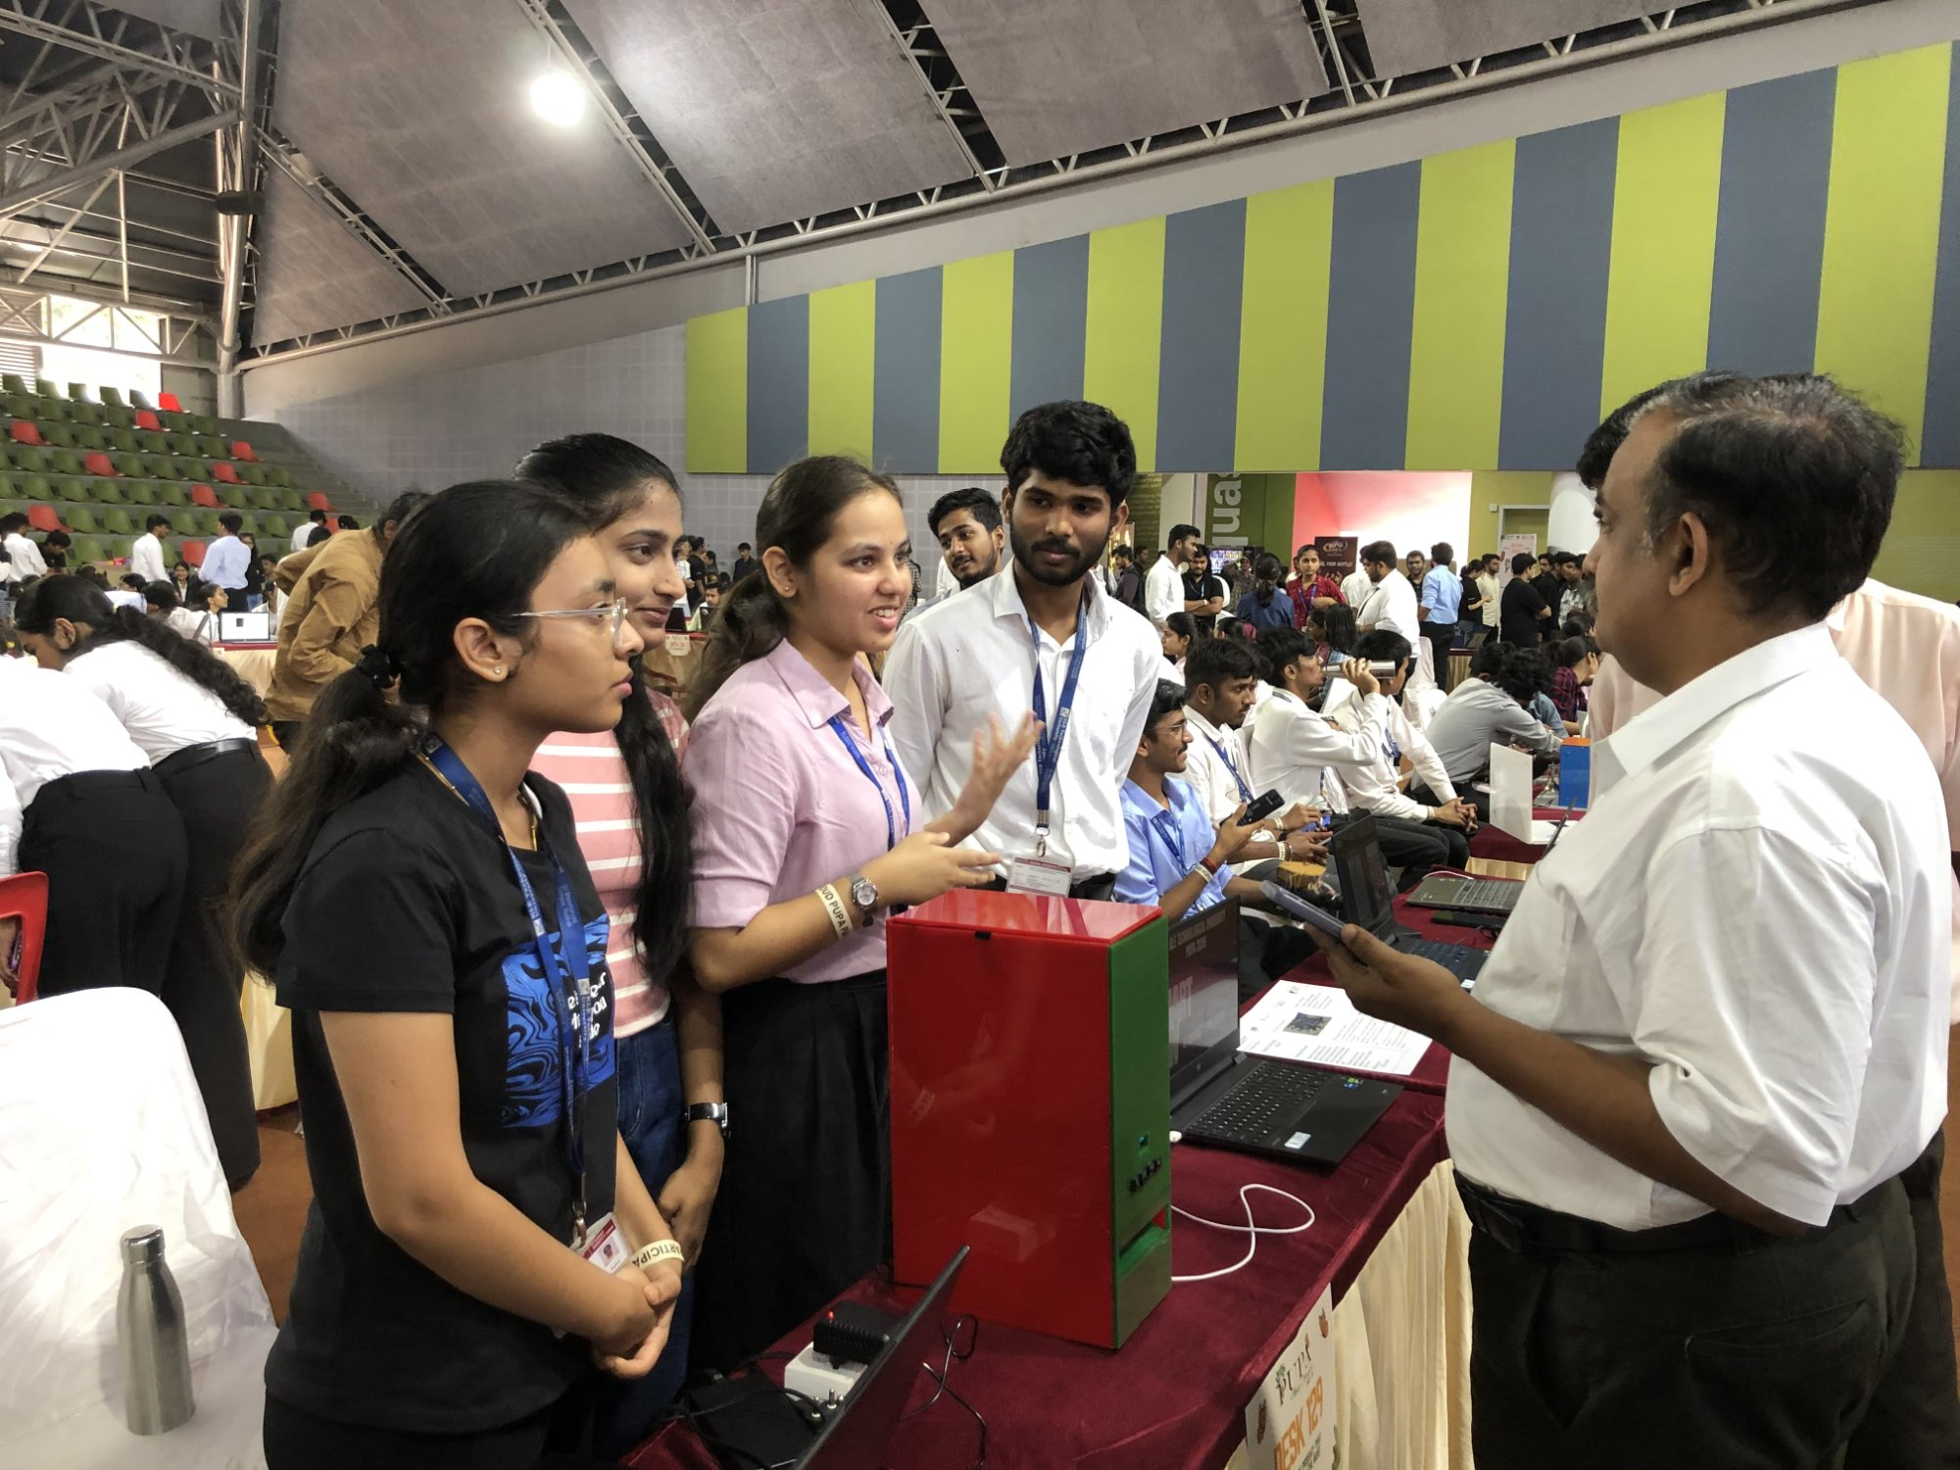
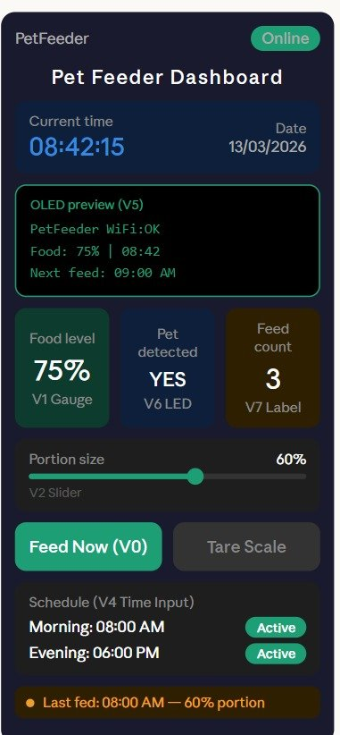
KLE Technological University | Dept. of Automation & Robotics | PUPA 2k25-26
IoT-Based Automatic Pet Feeder
🏆 Showcase 2025
Team: IoT-Based Automatic Pet Feeder Bot
Smart Remote-Controlled Dog Feeding System via Blynk & ESP32
⚠ Problem Statement
📷 Live at the Exhibition
📱 Blynk App Dashboard
Pet owners who travel or work long hours often miss scheduled feeding times, leaving dogs underfed or overfed. Manual feeding is inconsistent and requires physical presence.
Our IoT-enabled system lets owners feed pets remotely, schedule meals, track portion sizes, and monitor food levels — from anywhere in the world.
🧾 Bill of Materials
Component | Qty | Cost
ESP32 DevKit V1 | 1 | ₹500
OLED SSD1306 (0.96") | 1 | ₹180
HC-SR04 Ultrasonic | 1 | ₹80
MG996R Servo Motor | 1 | ₹350
Push Buttons (4×) | 4 | ₹60
Li-ion Battery + Case | 1 | ₹300
Jumper Wires + PCB | 1 set | ₹100
Enclosure + Container | 1 | ₹350
Misc | — | ₹80
📡
WiFi
ESP32
⏰
3× Daily
Schedules
📊
Food Level
Monitor
🖥
OLED
Display
🔘
Manual
Switches
⚙ How It Works
💰 Selling Price: ₹ 3,000
1
Power On: ESP32 boots, connects to WiFi & Blynk cloud automatically.
2
OLED Startup: Displays time, next feed schedule, food level & last feed info.
🎯 Target Customers
🐶 Pet Owners (Busy Professionals)
✈ Frequent Travelers / WFH Workers
🏠 Smart Home Enthusiasts
🐾 Dog/Cat Breeders & Kennels
🏢 Pet Clinics & Shelters
Schedule/Manual: Set morning/afternoon/evening feeds via Blynk or 4 push buttons.
Food Dispensing: MG996R servo rotates to open gate and dispenses set portion.
🔌 System Block Diagram
3
4
📱 Blynk App (Cloud)
Level Sensing: HC-SR04 ultrasonic measures food level; OLED shows real-time status.
Remote Control: 'Feed Now' on Blynk app triggers instant dispensing from anywhere.
🧠 ESP32 DevKit V1
5
6
OLED
Display
HC-SR04
Food Level
MG996R
Servo
✅ Control from Anywhere via Blynk
⏰ 3× Daily Auto-Scheduling
📊 Real-Time Food Level (Ultrasonic)
🖥 OLED: Feed Time + Level Display
🔘 4× Manual Push Buttons (Manual Override)
🔘 Manual Override Buttons
📡 WiFi-Enabled ESP32 DevKit V1

